Slide 1

General
Electric
Presented By:
Mohitha Edupuganti; Shivangi Jain; Sonu Aggarwal;
Swaroopa Pradhan; Swasti Johri
FIN 600001 - Corporate Finance: Project Presentation

Slide 2
Introduction
General Electric is an American Multinational company. It has been a publicly traded company, traded on the New York Stock Exchange.The company has several divisions, including aerospace, power, renewable energy, digital industry, additive manufacturing, and venture capital and finance.
Founder – Thomas Edison; J. P. Morgan; Charles A. Coffin
Headquarters - Boston, Massachusetts, U.S.
Founded - 1892 (131 years ago)
Industry - Computers, aviation, power, renewable energy, digital industry, additive manufacturing
and venture capital and finance.
Total Employees – 172,000
Countries - More than 170 countries, and have invested in emerging markets for more than 100 years.
Mission Statement - “We rise to the challenge of building a world that works.”
According to gross sales, GE was the 33rd-largest company in the United States according to the Fortune 500 in 2020. GE was the 14th most profitable business in the Fortune 20 in 2011, but when its profitability declined, it very significantly underperformed the market (by nearly 75%). $18 BILLION contributed to U.S. Gross Domestic Product (GDP).

Slide 3
GE Businesses
The corporation declared on November 9, 2021, that it would split into three publicly traded companies. GE announced the brand names of the businesses it intends to separate into GE Aerospace, GE HealthCare, and GE Vernova on July 18, 2022. The new businesses will concentrate on renewable energy, digital, and aerospace as well as healthcare.
January 4, 2023, saw the completion of GE HealthCare's first spin-off; GE still owns 13.5% of the company and plans to sell the remaining shares over time. The spin-off of GE's energy portfolio, which is slated to become GE Vernova in 2024, will come next. After these deals, GE will become a firm that focuses on aviation; GE Aerospace will be the old GE's legal successor.
GE's primary business divisions are: GE Additive; GE Aerospace; GE Capital; GE Digital; GE Healthcare; GE Power; GE Renewable Energy; GE Research. Through these businesses, GE participates in markets that include the generation, transmission and distribution of electricity (e.g. nuclear, gas and solar), industrial automation, medical imaging equipment, motors, aircraft jet engines, and aviation services. GE gauges to control a railway locomotive at a museum near Saskatoon, Canada General Imaging manufacturers GE digital cameras.

Slide 4
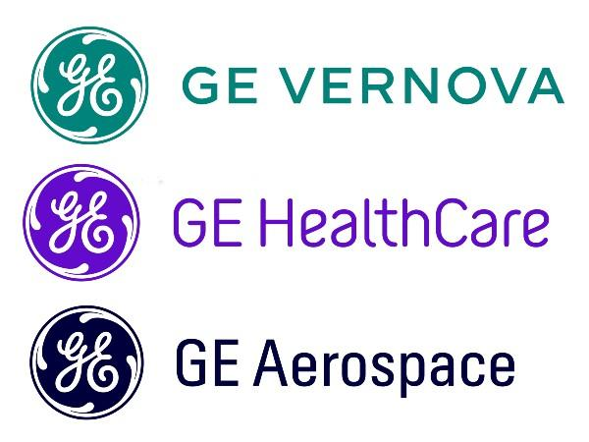
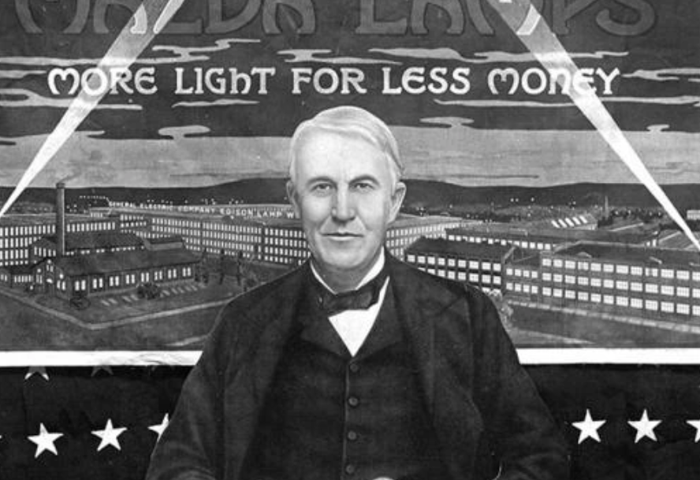
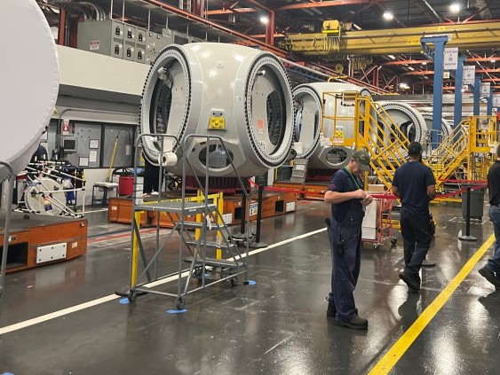
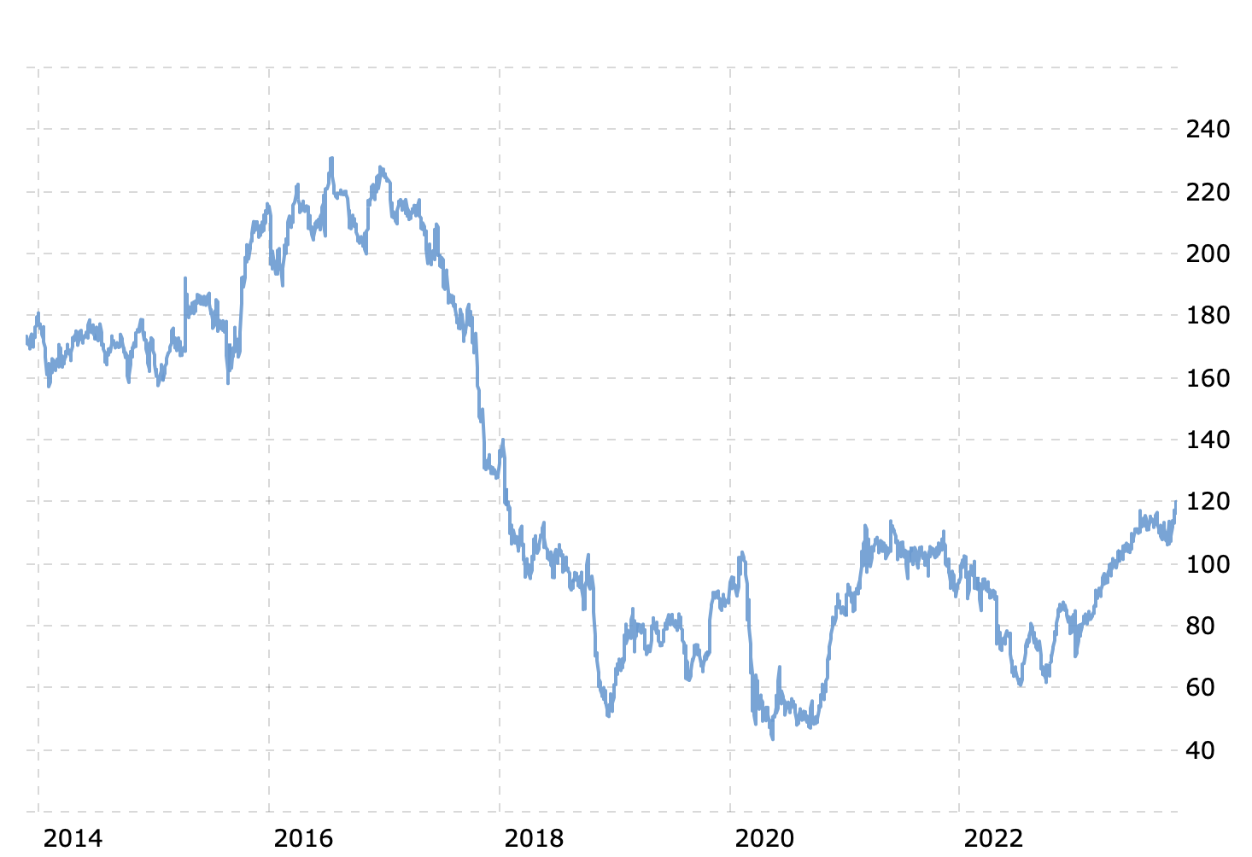
Why General Electric (GE)
Diverse Portfolio
- Aviation
- Power
- Renewable energy
- Financial Services
- Recent Spinoffs
Long Standing
Market Presence
- Started in 1892
- Listed in NYSE 1983
Innovation and RD
- Lightbulbs
- Carbon Free Engines
- Adaptive Flight Engine
Recent Financial Challenges
- GE Healthcare Spinoff
- 197.27 USD, Dec 30, 2016
- 51.38 USD, Jan 16, 2019
- 119.60 USD, Nov 22, 2023

Slide 5

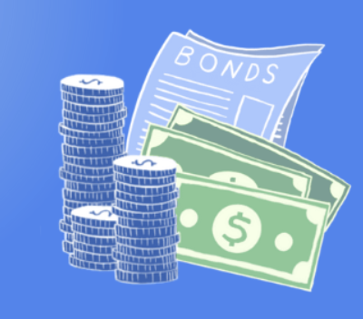


Financial Statement Analysis (10-Q Report)
Dec 2022 vs Sept 2023
Total Assets decreased from $188.9 billion to $156.7. $30 billion decrease in assets was due to discontinued operations
Cash, Cash Equivalents and restricted cash also decreased from $15.8 billion to $13.1 billion by $2.7 billion. These decreases were partially offset by a $2 billion increase in inventories and deferred inventory costs as well as a $0.8 billion increase in all other assets.
Total liabilities decreased from $153.9 billion to $126.8 billion, mainly due to a reduction in long-term borrowings and liabilities of discontinued operations.
Shareholders' equity decreased from $33.7 billion to $28.7 billion, impacted by changes in accumulated other comprehensive income and retained earnings
Overall, the financial position suggests a shift in GE's asset composition, potential strategic changes, and ongoing efforts to manage liabilities.The changes in assets, liabilities and equity indicate GE divested some businesses while continuing to build inventory, resulting in lower cash balances, and experienced foreign currency translation losses running through equity.

Slide 6
Capital Budgeting (Investment)
Capital Expenditures (CapEx) Ratio:
Capital Expenditures
Total Assets
CapEx Ratio =
x 100
Where,
CapEx = PP&E (2023) - PP&E (2022)
= $12,203 million−$12,192 million = $11 million
Total Assets = Total Assets figure from the balance sheets for 2022 and 2023
CapEx Ratio₂₀₂₃ =
$11 Million
$156,662 Million
x 100 = 0.007%
CapEx Ratio₂₀₂₂ =
$11 Million
$188,851 Million
x 100 = 0.006%
Source: https://www.sec.gov/edgar/searchedgar/companysearch.html
Notes:
Capital budgeting is crucial for GE's growth strategy, shaping its industry presence and facilitating informed investment decisions across diverse sectors emphasizing long-term vision, innovation, and significant investments in R&D.

Slide 7
Capital Budgeting (Investment)
ANALYSIS
ADDITIONAL CONSIDERATIONS
INFERENCE
Comparative Analysis: The marginal increase in the CapEx Ratio from 2022 to 2023 indicates a slightly heightened emphasis on capital expenditures concerning General Electric's total asset base. Although the change seems incremental, it signals a potential focus on investing in and enhancing tangible assets, aligning with strategic goals for sustainable growth and development.
Purchases of PP&E: The increase in PP&E suggests that there is a significant investment in tangible assets, indicating potential expansion or upgrades in infrastructure and facilities.
R&D Expenditures: The upward trend in R&D spending showcases GE's continued focus on innovation and research-driven initiatives, indicating a commitment to long-term growth and technological advancements.
Management's Discussion and Analysis (MD&A): The MD&A section highlights GE's commitment to innovation-driven investments, specifically mentioning plans to increase R&D spending by 5% annually for the next five years. Additionally, it discusses a strategic expansion initiative in renewable energy, requiring a $1 billion investment in PP&E over the next two years.
GE's outlined strategies emphasize a consistent focus on innovation through increased R&D spending and a targeted expansion plan in renewable energy.
The company's investment aligns with growth objectives by leveraging technology and expanding into sustainable energy sectors.

Slide 8
Capital Structure (Financing)
Short-Term Financing Status:
A decreasing Current Ratio indicates a potential decline in short-term liquidity or the ability to cover immediate obligations with current assets.
Potential Reasons for the Decrease:
Changes in Current Assets and Liabilities: A reduction in current assets or an increase in current liabilities might contribute to the lower ratio.
Efficiency in Managing Short-Term Resources: GE might have optimized its working capital or managed its short-term resources differently, impacting the ratio.
Shifts in Operations or Debt Management: Changes in operational strategies, sales, or debt management might have influenced the ratio.
Possible Implications:
Reduced Liquidity Buffer:The decrease suggests a slight reduction in GE's ability to cover its short-term liabilities with current assets.
Management of Working Capital: It could indicate a shift in how GE manages its working capital, which might impact its ability to meet short-term obligations.
Current Assets
Current Liabilities
Current Ratio =
$56,434 Million
$48,164 Million
Current Ratio₂₀₂₃ =
Current Ratio₂₀₂₃ = 1.1717
$58,384 Million
$49,428 Million
Current Ratio₂₀₂₂ =
Current Ratio₂₀₂₂ = 1.1811
Source: https://www.sec.gov/edgar/searchedgar/companysearch.html
Notes:
CONCLUSION: While the decrease in the Current Ratio suggests a potential reduction in short-term liquidity, deeper analysis into the components driving this change and insights from management discussions would offer a more comprehensive understanding of GE's short-term financing status and liquidity position.

Slide 9
Capital Structure (Financing)
Short-Term Financing Status:
A decreasing Quick Ratio indicates that either current assets have decreased, or current liabilities have increased, or both.
Potential Reasons for the Decrease:
Decrease in Current Assets: A decline in cash, marketable securities, or accounts receivable could reduce the numerator of the quick ratio.
Increase in Inventory: An increase in inventory can negatively impact the quick ratio since inventory is excluded from the quick assets.
Increase in Current Liabilities: An increase in short-term obligations, such as accounts payable or short-term debt, would raise the denominator of the quick ratio, resulting in a lower ratio.
Possible Implications:
Liquidity Concerns: A quick ratio below 1 suggests that the company may have difficulty covering its short-term obligations.
Creditworthiness: Creditors and investors often assess a company's quick ratio as part of their evaluation of creditworthiness. A declining ratio may affect the company's ability to negotiate favorable credit terms or attract investors.
Current Assets - Inventory
Current Liabilities
Quick (or Acid-Test) Ratio =
Quick (or Acid-Test) Ratio₂₀₂₃ =
$56,434 Million - $17,020 Million
$48,164 Million
Quick (or Acid-Test) Ratio₂₀₂₃ = 0.8183
Quick (or Acid-Test) Ratio₂₀₂₂ =
$58,384 Million - $14,891 Million
$49,428 Million
Quick (or Acid-Test) Ratio₂₀₂₂ = 0.8799
Source: https://www.sec.gov/edgar/searchedgar/companysearch.html
Notes:
CONCLUSION: While the decrease in the Current Ratio suggests a potential reduction in short-term liquidity, deeper analysis into the components driving this change and insights from management discussions would offer a more comprehensive understanding of GE's short-term financing status and liquidity position.

Slide 10
Capital Structure (Financing)
Short-Term Financing Status:
Cash Ratio =
Cash
Current Liabilities
A decreasing Cash Ratio indicates that the company may not be able to cover all of its short-term liabilities with its available cash.
Potential Reasons for the Decrease:
Decrease in Cash and Cash Equivalents: A reduction in the amount of cash or easily convertible short-term investments.
Increase in Current Liabilities: An increase in short-term obligations, such as accounts payable or short-term debt, which would raise the denominator of the cash ratio.
Possible Implications:
Liquidity Concerns: A cash ratio below 1 suggests that GE may have challenges covering its short-term liabilities with its available cash. This could raise concerns about liquidity risk.
Financial Stability: The decline in the cash ratio may be seen as a signal of reduced financial stability and the need for careful management of short-term obligations.
$13,127 Million
$48,164 Million
Cash Ratio₂₀₂₃ =
Cash Ratio₂₀₂₃ = 0.2725
Cash Ratio₂₀₂₂ =
$15,810 Million
$49,428 Million
Cash Ratio₂₀₂₂ = 0.3198
Source: https://www.sec.gov/edgar/searchedgar/companysearch.html
Notes:
CONCLUSION: While the decrease in the Current Ratio suggests a potential reduction in short-term liquidity, deeper analysis into the components driving this change and insights from management discussions would offer a more comprehensive understanding of GE's short-term financing status and liquidity position.

Slide 11
Capital Structure (Financing)
Long-Term Financing Status:
Total Asset - Total Equity
Total Asset
EBIT
Interest
Total Debt Ratio =
Times Interest Earned =
Dec 2022
0.8151 times
Dec 2022
2.627 times
Sep 2023
0.8095 times
Sep 2023
22.96 times
A total debt ratio of 1 indicates that all of the company's assets are financed by debt, while a ratio of 0 means that the company is not using any debt to finance its assets.
Implications of the total debt ratio:
Financial Leverage: A lower total debt ratio suggests less financial leverage, which can be positive as it indicates a lower reliance on debt financing.
Risk Management: A decrease in the total debt ratio indicate that the company is managing its debt levels, potentially reducing the risk of financial distress.
A higher TIE ratio indicates a greater ability of the company to cover its interest obligations.
Implications of the TIE ratio:
Improved Financial Health: Increase in the TIE ratio suggests that GE's earnings are substantially higher relative to its interest expenses. This can be a positive sign of improved financial health.
Debt Servicing Capability: A higher TIE ratio indicates a more comfortable position in servicing interest payments, reducing the risk of default on debt obligations.
Notes:
Implications of the total debt ratio:
Financial Leverage:
A lower total debt ratio suggests less financial leverage, which can be positive as it indicates a lower reliance on debt financing. However, it's essential to consider the industry norms and the company's specific financial strategy.
Risk Management:
A decrease in the total debt ratio may indicate that the company is managing its debt levels, potentially reducing the risk of financial distress.
Cost of Capital:
A lower total debt ratio could impact the company's cost of capital. Less reliance on debt might lead to a lower cost of capital, which can be advantageous for the company.
Financial Health:
While a lower total debt ratio can be a positive indicator, it's important to assess the overall financial health of the company by considering other financial ratios and factors.
Investors and analysts often use the total debt ratio as part of a comprehensive analysis to understand a company's capital structure and financial risk. It's recommended to interpret the ratio in the context of the company's industry, business model, and broader economic conditions.

Slide 12
Capital Structure (Financing)
Long-Term Financing Status:
The Debt-to-Equity Ratio has decreased from 4.5684 in 2022 to 4.4245 in 2023.
Potential Implications:
Reduced Reliance on Debt:The decrease suggests a relatively lower reliance on debt in financing GE's operations compared to shareholder equity.
Shifts in Capital Structure:GE might have altered its capital structure, potentially reducing debt or increasing equity.
Improved Financial Health: A decreasing ratio often indicates a healthier financial position in terms of long-term solvency and stability.
Total Liabilities
Total Shareholders’ Equity
Debt-to-Equity Ratio =
$126,830 Million
$28,665 Million
Debt-to-Equity Ratio₂₀₂₃ =
Debt-to-Equity Ratio₂₀₂₃ = 4.4245
$153,938 Million
$33,696 Million
Debt-to-Equity Ratio₂₀₂₂ =
Debt-to-Equity Ratio₂₀₂₂ = 4.5684
Source: https://www.sec.gov/edgar/searchedgar/companysearch.html
Notes:
CONCLUSION: The decrease in the Debt-to-Equity Ratio suggests a potential reduction in GE's reliance on debt for financing its operations, signaling a shift towards a more balanced or equity-oriented capital structure. Further exploration into specific changes in debt levels, industry comparisons, and management insights would provide a comprehensive understanding of GE's long-term financing status and its implications on the company's financial health and strategic direction.

Slide 13
Risk and Return Analysis in the Stock Market
GE Beta is a measure of systematic risk that indicates the sensitivity of a stock's returns to changes in the overall market.
It measures the volatility of a stock or how much GE's stock price is likely to move in relation to the market.
Beta is calculated by comparing the historical returns of GE's stock to the historical returns of the market index.
General Electric Company (GE) exhibits a Beta of 1.20
IMPLICATIONS
A beta of 1 indicates that the stock's price will move with the market, while a beta greater than 1 indicates that the stock is more volatile than the market, and a beta less than 1 indicates that the stock is less volatile than the market.
This implies that, on average, GE's stock price tends to move about 20% more than the overall market.
When a stock is described as having "moderately higher volatility," it suggests that the stock tends to be more responsive to market movements, and investors should be aware of the associated risks and rewards.
BETA MEASURE
Notes:
Implications: For investors, higher volatility means potentially higher returns, but it also comes with increased risk. The stock may experience larger price swings, and its performance may be influenced by market fluctuations to a greater extent. Investors with a higher risk tolerance might find such stocks appealing, but others might be more cautious. In summary, when a stock is described as having "moderately higher volatility," it suggests that the stock tends to be more responsive to market movements, and investors should be aware of the associated risks and rewards.

Slide 14
Holding Period Return
Holding Period Return (HPR) is the total gain or loss on an investment, factoring in changes in value and any income like dividends, calculated as a percentage for a specific period.
Holding Period Return (HPR) is the percentage change in investment value over a period, accounting for both capital gains and any income, like dividends.
Remarkable return reflects positive market performance
Return Standard Deviation is a measure of the volatility or risk of an investment's returns.
It measures how much the returns of an investment vary from the average return over a specific period of time.
Standard deviation value is 29.45
6-Month HPR (From May 31, 2023, to Nov 24, 2023):
Pi​ (May 31, 2023) = $109.85 (Closing Price)
Pt​ (Nov 24, 2023) = $119.97 (Closing Price)
HPR = 9.358
12-Month HPR (From Nov 24, 2022, to Nov 24, 2023):
Pi​ (Nov 24, 2022) = $67.11 (Closing Price)
Pt​ (Nov 24, 2023) = $119.97 (Closing Price)
HPR = 79.217
36-Month HPR (From Nov 24, 2020, to Nov 24, 2023):
Pi​ (Nov 24, 2020) = $80.48 (Closing Price)
Pt​ (Nov 24, 2023) = $119.97 (Closing Price)
HPR = 50.220
Notes:
36-month​=119.97−80.48+(0.062451×11+0.08×3)/80.48×100

Slide 15
Profitability Analysis
Profit Margin: 11.90%
Operating
Margin:
10.50%
Return on
Assets (ROA):
3.43%
Return on
Equity (ROE): 35.01%
Quarterly
Earnings
Growth:
116.10%
The profit margin represents the percentage of revenue that translates into profits after covering all expenses. GE's profit margin of 11.90% indicates that for every dollar of revenue, the company retains $0.119 as profit. This suggests a reasonable level of profitability.
The operating margin measures the efficiency of a company's operations by determining the percentage of revenue that covers operating costs. GE's operating margin of 10.50% suggests that the company is effectively managing its operating expenses.
ROA evaluates how efficiently a company utilizes its assets to generate profits. GE's ROA of 3.43% indicates that for every dollar of assets, the company generates $0.0343 in profit. A higher ROA is generally preferable, but this can vary by industry.
ROE assesses the profitability of a company in relation to shareholders' equity. GE's ROE of 35.01% implies that the company is generating a strong return on the equity invested by shareholders.
This metric reflects the percentage increase in earnings compared to the same quarter in the previous year. GE's significant earnings growth of 116.10% indicates a positive trend in its financial performance.

Slide 16
Profitability Forecast
 | Current Year (2023) | Next Year (2024)
Earnings Estimate | The average estimate for the current year is slightly higher than the year-ago EPS, indicating modest expected growth. The range reflects differing opinions among analysts. | The next year's average estimate shows a significant increase compared to the year-ago EPS, suggesting optimistic expectations for substantial growth. The range indicates varying opinions on the extent of this growth.
Revenue Estimate | The average estimate for the current year is lower than the year-ago sales, indicating an expected decrease. The negative sales growth percentage reflects potential challenges or adjustments impacting annual revenues. | The average estimate for the next year is higher than the year-ago sales, suggesting expectations for a recovery and growth. The positive sales growth percentage indicates optimism for improved revenue in the upcoming year.
Earnings Per Share (EPS) | For the current year (2023) and the next year (2024), there is a gradual increase in EPS estimates. This suggests a positive trend in the expected earnings for both the current and next fiscal years.
Growth Estimates | The modest growth estimate for the current year suggests a steady but not significant improvement. Investors may want to assess the company's strategies for sustained growth. | The higher growth estimate for the next year signals an optimistic outlook. Investors should explore the catalysts and potential risks associated with this growth projection. Next 5 Years = 31.38% The positive long-term growth estimate indicates an expectation of consistent growth over the next five years. Investors should consider the industry landscape, market trends, and GE's competitive position.

Slide 17
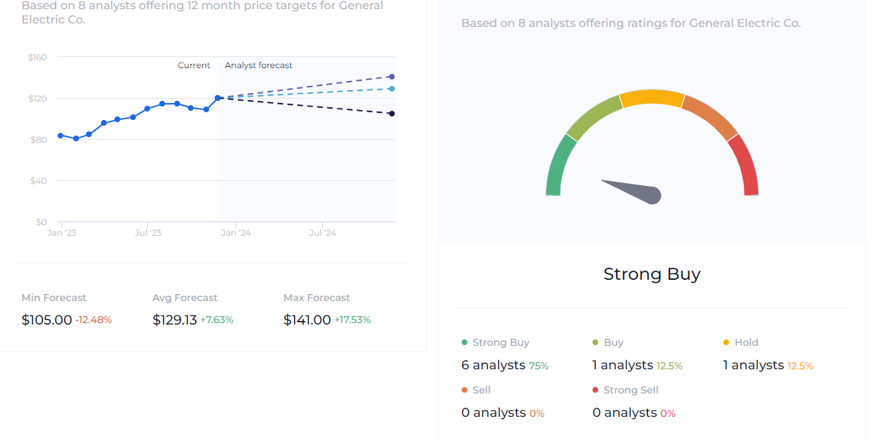
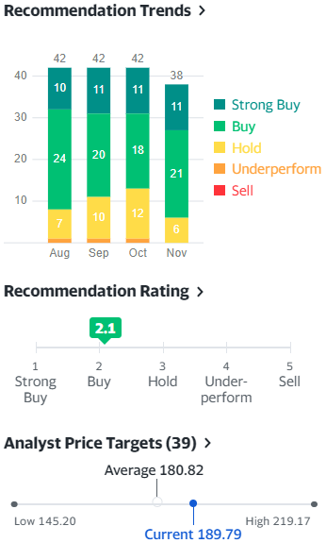
Analyst Forecast

Slide 18
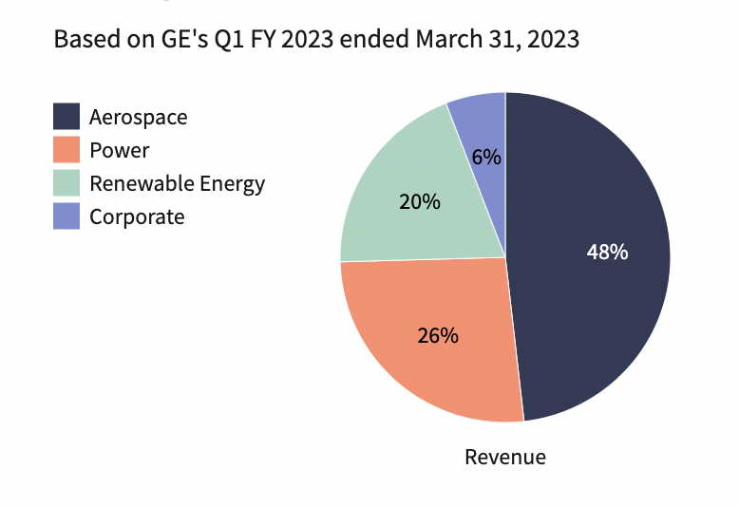
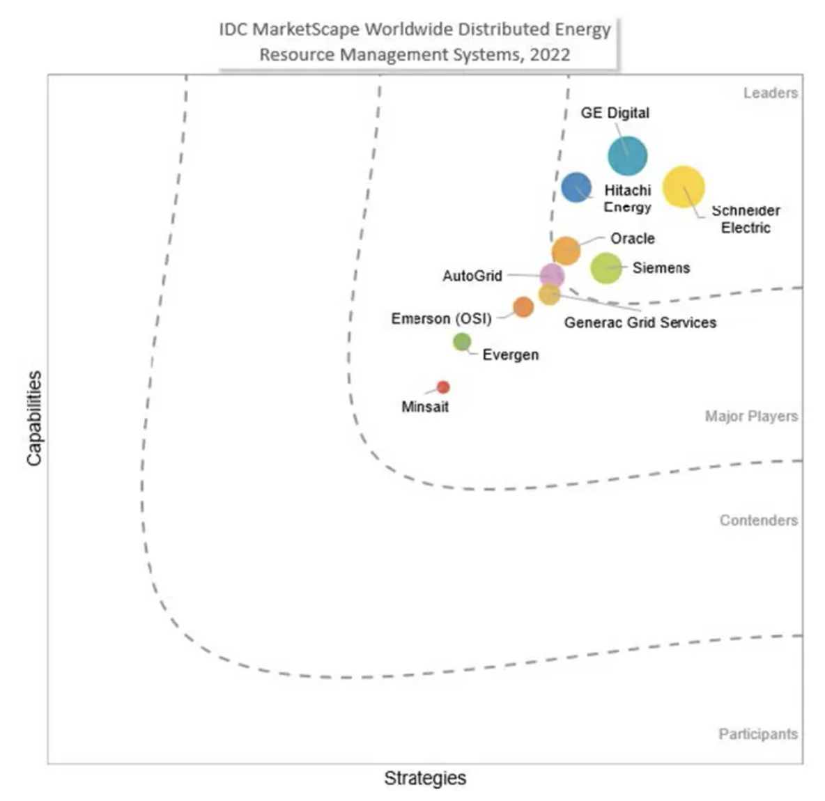
Industry & Market Analysis
GE is refocusing on segment that generates the most profit and revenue.
GE
RTX Corp
Lockheed M
Honeywell
General Electrical Market Analysis
Revenue
2022
76.6 Bn USD
67.07 Bn USD
65.98 Bn USD
35.47 bn USD
GE Global Revenue, 2022: 76.6 Bn USD
GE Share Price, 28th Nov, 2023: 119.97
GE Market Cap – 130.57 Bn USD
GE Overall Market share: 5.14%
GE has seen a 60% growth in stock prices despite the GE Healthcare spinoff
Stock Price
28th Nov
119.97
74.47
445.49
192.97
GE’s Largest Product Segment by Revenue - Aviation
GE Digital leading in the innovation space
Source: Investopedia, Statista, GE Electric

Slide 19
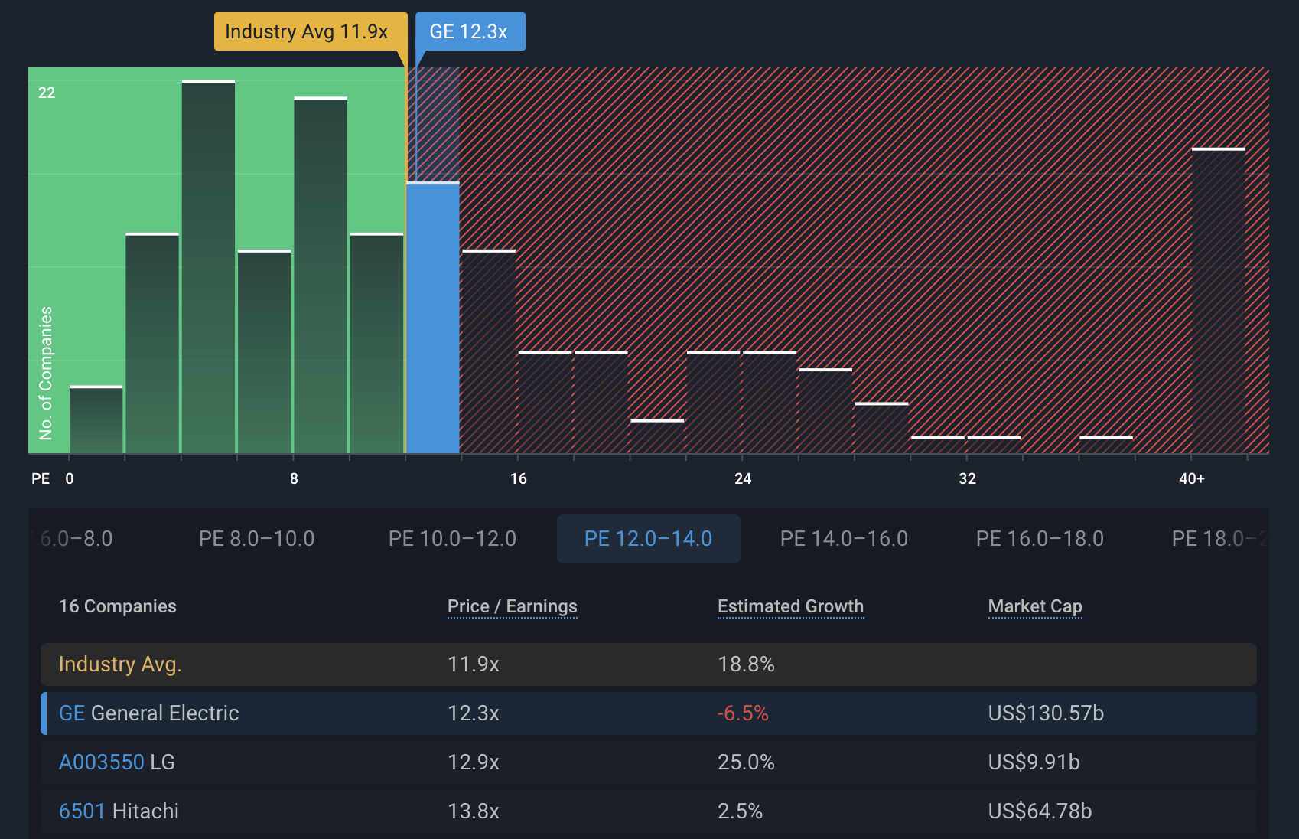
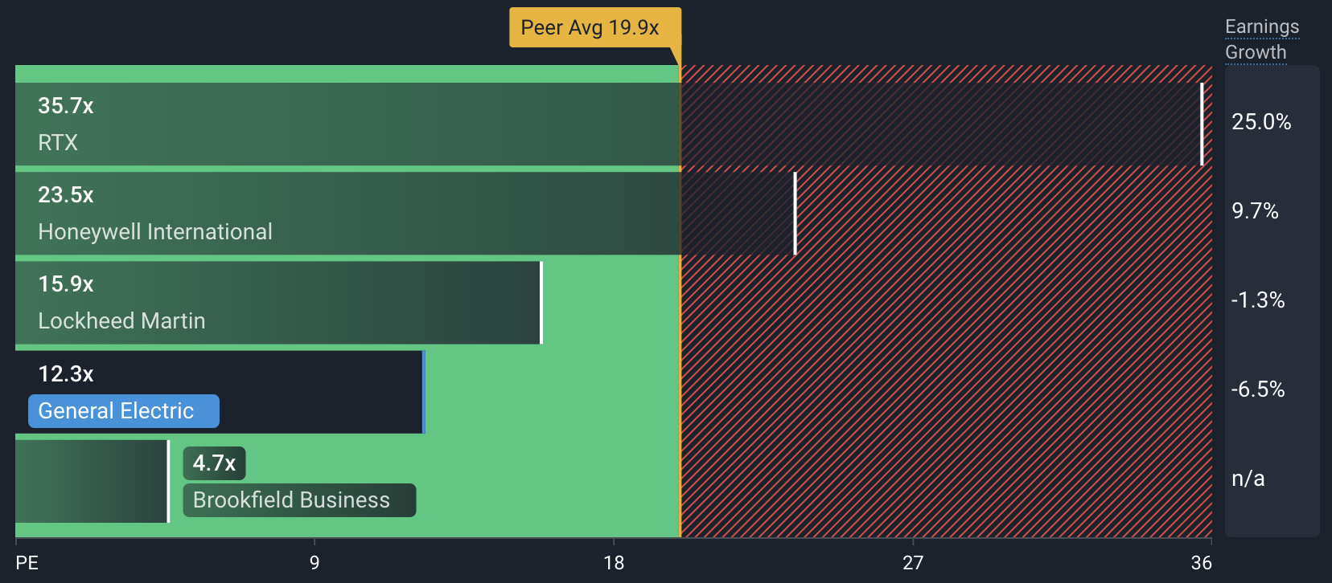
Industry & Market Analysis
GE has a Price-To-Earnings Ratio (12.3x)
GE is good value based on its Price-To-Earnings Ratio (12.3x) compared to the peer average (19.9x) in the US
GE is expensive based on its Price-To-Earnings Ratio (12.3x) compared to the Global Industrials industry average (11.9x)

Slide 20
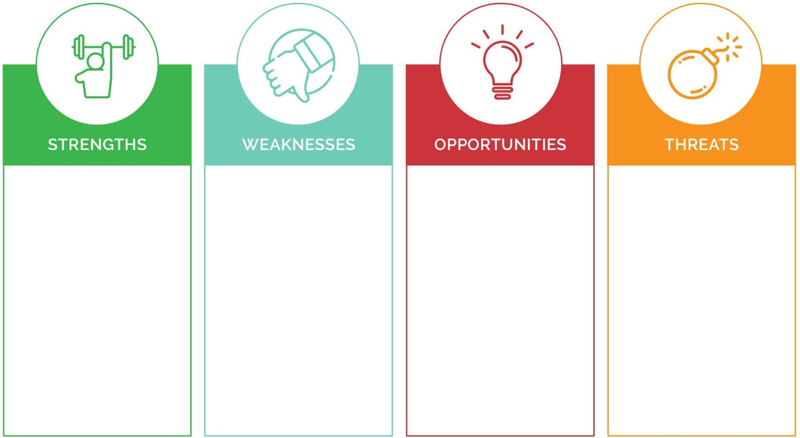
SWOT Analysis
Diverse portfolio bifurcating into niche capable market
Strong financial position
Low debt-to-equity ratio
Large customer base and distribution network
Innovative products and services
Struggling power and renewable energy divisions
Gaps in decision-making and internal communication
International sales dependency
Dependence on certain product lines
Growing demand of renewable energy, digital industrial solutions
Wind turbines and electric transportation
Strategic Partnerships and acquisitions
Expansion into emerging markets
Increased competition from both established players and emerging startups
Regulatory changes and environmental concerns
Thin spreading of resources
Potential geopolitical risks

Slide 21
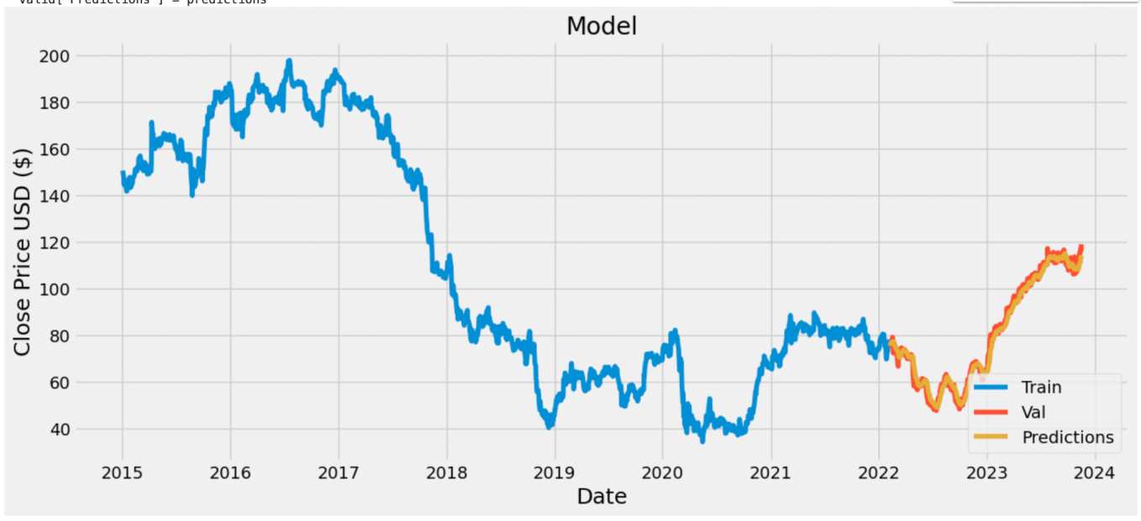
Valuation Analysis
The employment of a Long Short-Term Memory (LSTM) network was utilized for forecasting the stock price of GE.
Predicted Price: 117.05 USD
Using the LSTM network as training methodologies
10 year data
Training: 70% data, Testing: 30%
Experimentation:
Different Dates, Neurons
Collect Data:
Yahoo Finance
FRAMEWORK
Evaluation:
Root Mean Squared Deviation - RMSE
Features:
Closing Stock Price
Modeling:
Machine Learning - LSTM network
Source: Smart Portfolio
Notes:
LSTM (Long Short-Term Memory) is a recurrent neural network (RNN) architecture widely used in Deep Learning. It excels at capturing long-term dependencies, making it ideal for sequence prediction tasks. LSTM incorporates feedback connections, allowing it to process entire sequences of data, not just individual data points. This makes it highly effective in understanding and predicting patterns in sequential data like time series, text, and speech.

Slide 22
Thank You
Mohitha Edupuganti (me385); Shivangi Jain (sj785); Sonu Aggarwal (sa2762);
Swaroopa Pradhan (sp2958); Swasti Johri (sj769)

